Slide 1

Concept 1 – Introduction to Polymorphism
INSEARCH CRICOS provider code: 00859D I UTS CRICOS provider code: 00099F Insearch Limited is a controlled entity of the University of Technology Sydney (UTS), and a registered private higher education provider of pathways to UTS.

Slide 2

What is Polymorphism?
Different objects can react differently when the same method is called.
Polymorphism means many forms. In OO, it means that a characteristic can have a different meaning or behaviour in a different context.

Slide 3


What is Polymorphism?
Example: Consider a group of instruments
Each instrument can be played, but the method of play is different for each instrument.
So, guitar objects behave differently to piano objects when the method play() is called because Guitar & Piano classes have a different implementation for the play() method
A guitar is played in a different way to a piano

Slide 4
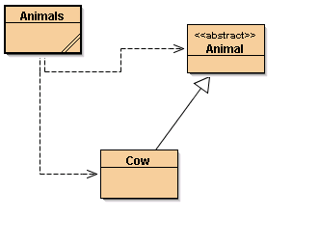
Do you remember these classes?

Slide 5
Review - Animals
The Cow class inherits from Animal and effects (provides implementation for) noise() the abstract method in the parent class.
Animals class has a list of Animal objects, in this example, Cow objects.
private LinkedList<Animal> animalList;
Attribute animalList is of type LinkedList where the objects have been declared as Animal (so we do not need to cast)

Slide 6
Review - Animals
The animalList attribute is created and populated in the Animals default constructor
animalList.add(new Cow("Clarabelle"));
animalList.add(new Cow());
animalList.add(new Cow("Buttercup"));
animalList.add(new Cow("Daisy"));
animalList.add(new Cow("Meg"));
There are now 5 elements in the List

Slide 7
Review - Animals
Animals :noise() gets each element in the list and calls noise() on each element.
for(Animal current : animals)
{
System.out.println(current.noise());
}

Slide 8

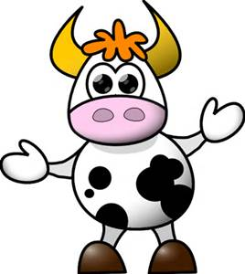
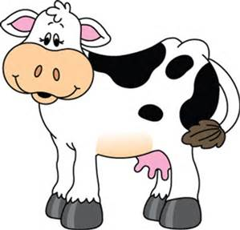
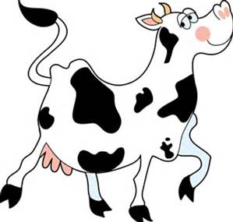
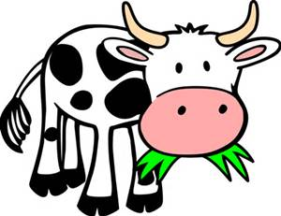
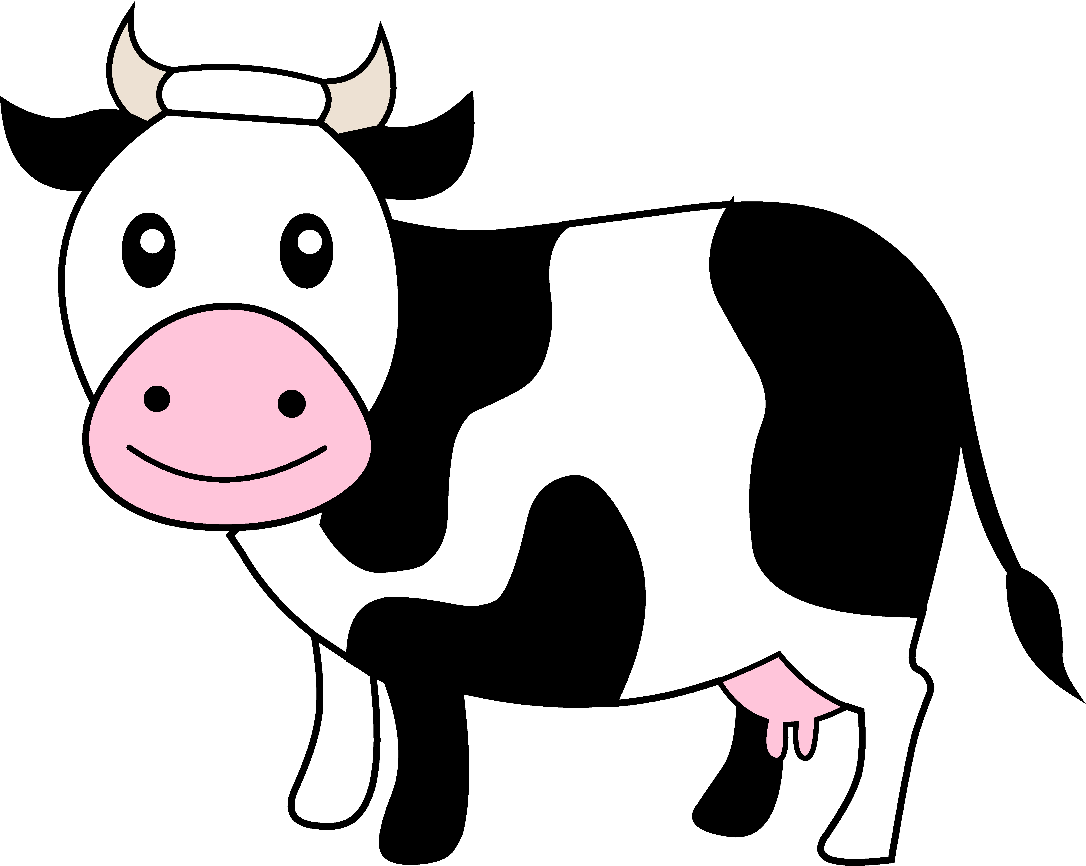
Review - Animals
The output of Animals:noise()

Slide 9

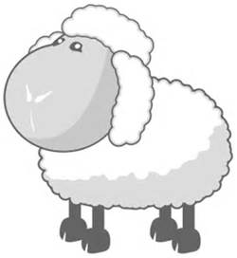
Lists Example
So far, we have only used homogeneous lists:
lists that hold objects of the same type
But a Sheep is an Animal, so we can populate the animalsList with Sheep objects too, IF SHEEP INHERITS FROM ANIMAL

Slide 10
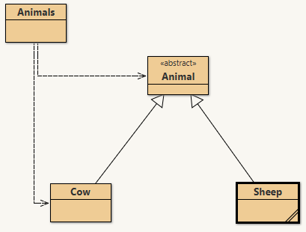
Updated: with Sheep class

Slide 11
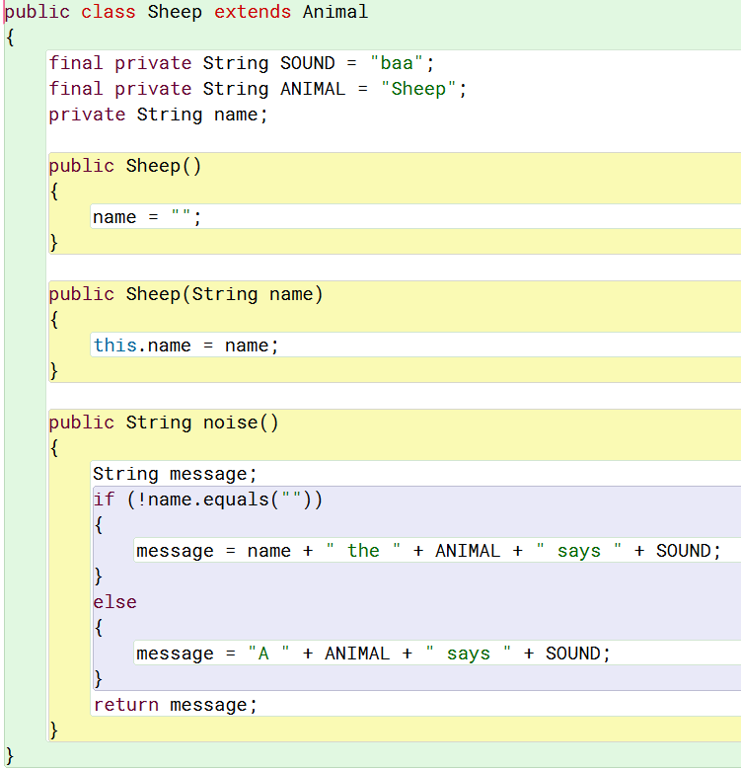
The Sheep Class

Slide 12
Sheep Class – Animals Code Example
The Sheep class inherits from Animal and effects (provide implementation for) noise() the abstract method in the parent class.
Abstract method noise() in Animal class – line 11
Sheep inherits from Animal – line 69
Sheep default constructor – line 80
Sheep alternate constructor – line 87
Sheep effects noise() – line 98

Slide 13
Revisit Animals Example
See Animals Code Example
5 elements in the list:
Element 1 - new Sheep()
Element 2 - new Cow("Clarabelle")
Element 3 - new Cow()
Element 4 - new Sheep("Dolly")
Element 5 - new Cow("Buttercup")
Iterate through the list and call noise() for each element
lines 142-145
Element 1 - current.noise() – line 98
Output: A Sheep says baa
Element 2 - cow.noise() – line 51
Output: Clarabelle the Cow says moo

Slide 14
Revisit Animals Example
See Animals Code Example
When calling noise() for each element in the list, different methods are actually being used
The 1st time the loop executes, current is element 1 – a Sheep object:
current.noise() – this uses noise in the Sheep class on line 98
Output: A Sheep says baa
The 2nd time the loop executes, current is element 2 – a Cow object:
current.noise() – this uses noise in the Cow class on line 51
Output: Clarabelle the Cow says moo

Slide 15
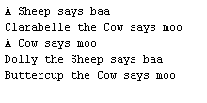
Revisit Animals Example
All are Animal objects, when we iterate through list and call noise() for each animal
Line 144 - Simple but so powerful
Objects are treated the same but result is different for each object
This is Polymorphism

Slide 16
Summary: Polymorphism
The term polymorphism refers to the practice of treating objects (of different types) the same; that is, they all supply the same interface.
The differences are hidden inside the methods: each class offers the same methods, but the implementation is different for each class.
We can declare the type of the list to be the parent type. We can then store any object of the parent class, or of a child class, in the list.

